Slide 1
React query

Slide 2
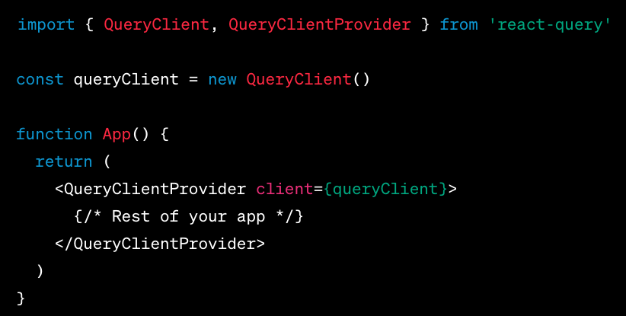
Set up
npm install react-query
You'll want to wrap your React application in the QueryClientProvider component to provide the necessary context.

Slide 3
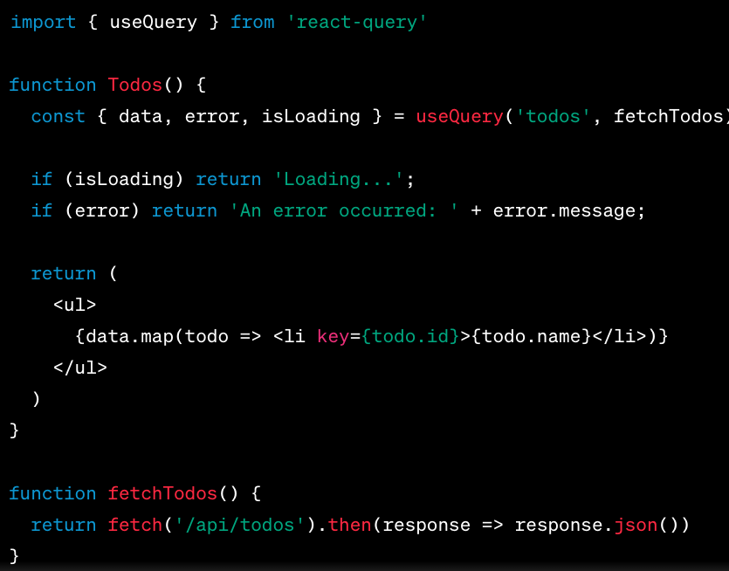
Fetching Data

Slide 4
Key Concepts
Query Keys: The first argument to useQuery is the query key. It's an array or string that uniquely identifies the query. It helps React Query manage and cache the data.
Query Function: The second argument is the function that fetches your data.
Query Result: The useQuery hook returns an object with the query result, which includes properties like data, error, isLoading, etc.

Slide 5
Mutations
When you want to change data on the server, you'll use useMutation:

Slide 6
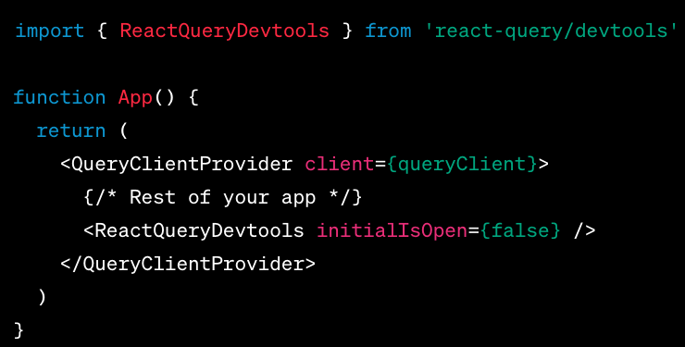
Devtools
npm install react-query/devtools

